Slide 1
Analysing localities for Gambling Centre
We identified top localities for opening a Gambling Centre

Slide 2
Table of Contents
Understanding the problem
Data Requirement
Data Collection
Preparing the data
Plotting the graph to locate clusters
Deployment
Feedback

Slide 3

Understanding the problem
As we concluded that……
Client asked us, Where they should open a Gambling Centre in Toronto, Canada ?
Now me and my team understood the problem, so we initiated the process…..

Slide 4
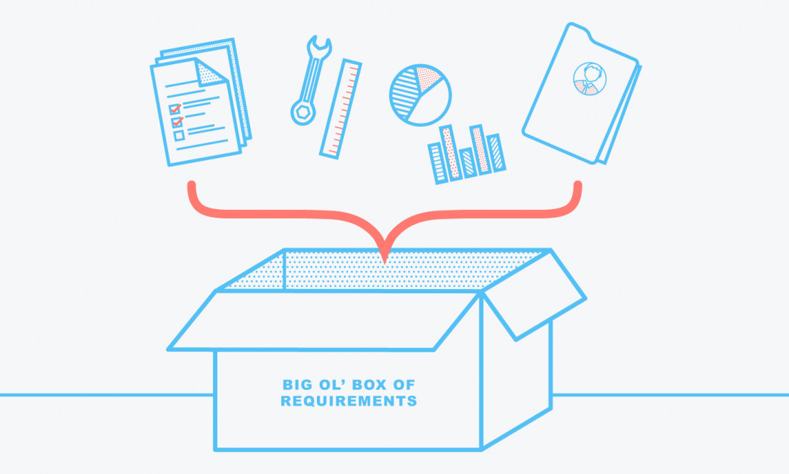
Data Requirement
For this project the dataset of neighbourhoods of the city of Toronto is needed.
Also we have come to know that the dataset must have the geographical coordinates of the various neighbourhoods.

Slide 5
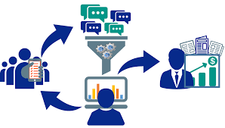
Data Collection
The dataset for our project was not readily available, so we have collected it from the web.
To do that we have used the Web-Scrapping approach.
The Collected data has been processed further and we got the dataset that we wanted.

Slide 6
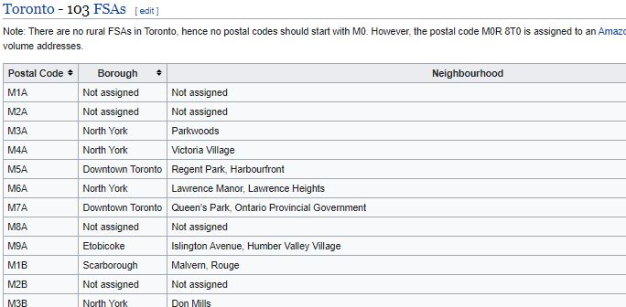
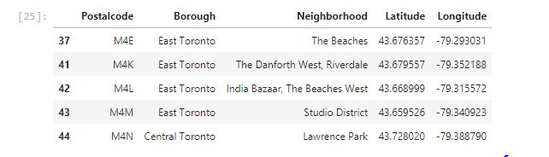
Comparison of dataset
Before Web-scrapping
After Web-scrapping

Slide 7
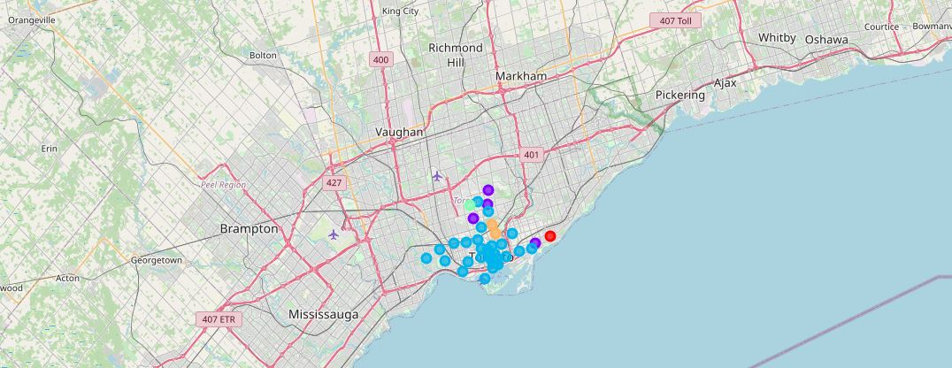
Locating Clusters on Map

Slide 8
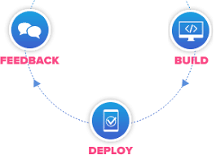
Deployment and Feedback
After all the analysis we give our results to our client.
If the client is still not satisfied then we will get a feedback from them and ask them where should we improve.
And in the end, when the client is satisfied with our work we’ll deploy the model.

Slide 9
Thank you!

